Slide 1
Task 4: Execution – substantive testing Part 1

Slide 2
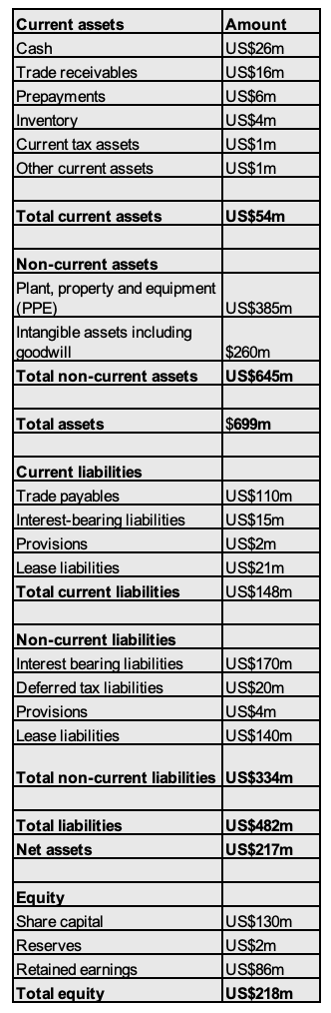
Balance sheet as at year-end
Balance sheet discrepancies
Observations to be raised with your senior:
1 - Balance sheet doesn't balance (out by US$1m).
2 - Current assets are less than current liabilities.

Slide 3
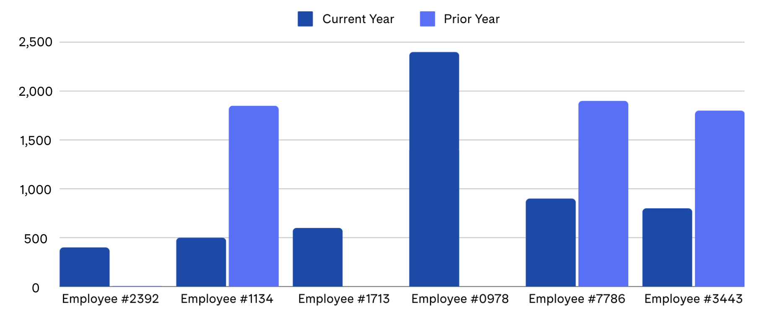
Number of journals posted by finance team employees
Observation to be raised with your senior:
The majority of journal entries are being prepared by employee #0978 (which could indicate segregation of duties issue), although, on a positive note, more employees prepared journal entries this year compared with last year.

Slide 4
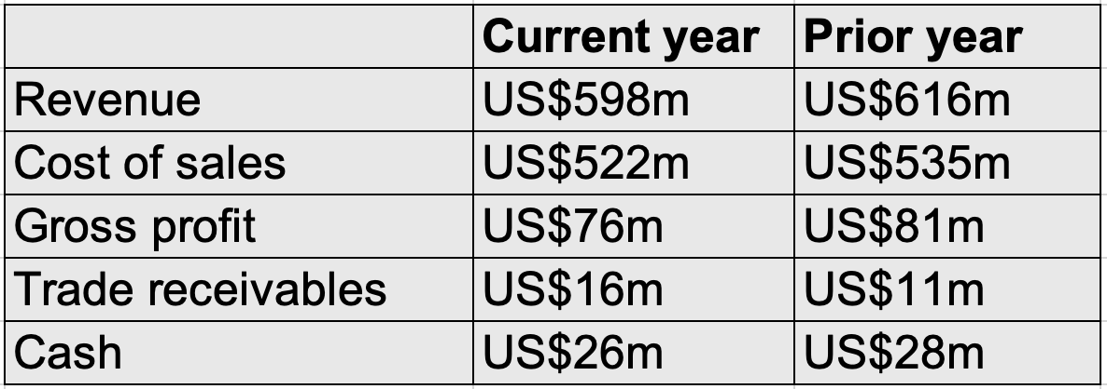
Snapshot of key financial metrics profit and loss and balance sheet
Observations to be raised with your senior:
Revenue has decreased during the current year, but Trade receivables have increased.

Slide 5
This publication contains information in summary form and is therefore intended for general guidance only. It is not intended to be a substitute for detailed research or the exercise of professional judgment. Member firms of the global EY organization cannot accept responsibility for loss to any person relying on this article.

